Slide 1

Industrial Training Report
(Subject Code- 22057)
-By Pranjal Save

Slide 2
Details
Name: Pranjal Yogesh Save
Company Name: CSism Technologies
Enrollment Number: 2216020037
Mentor: Mrs. Karishma Tamboli

Slide 3


Company Overview
The company began as a freelance venture while its founders completed college .
In 2012, The business officially launched, starting as an institute offering coaching classes.
The institute evolved into a full-fledged software development company.
Technologies Used: HTML, CSS, JavaScript, SQL, PHP
Founder: Mr. Ashutosh Ghaiwal Mentor for Internship: Mr. Rohit Solanki

Slide 4
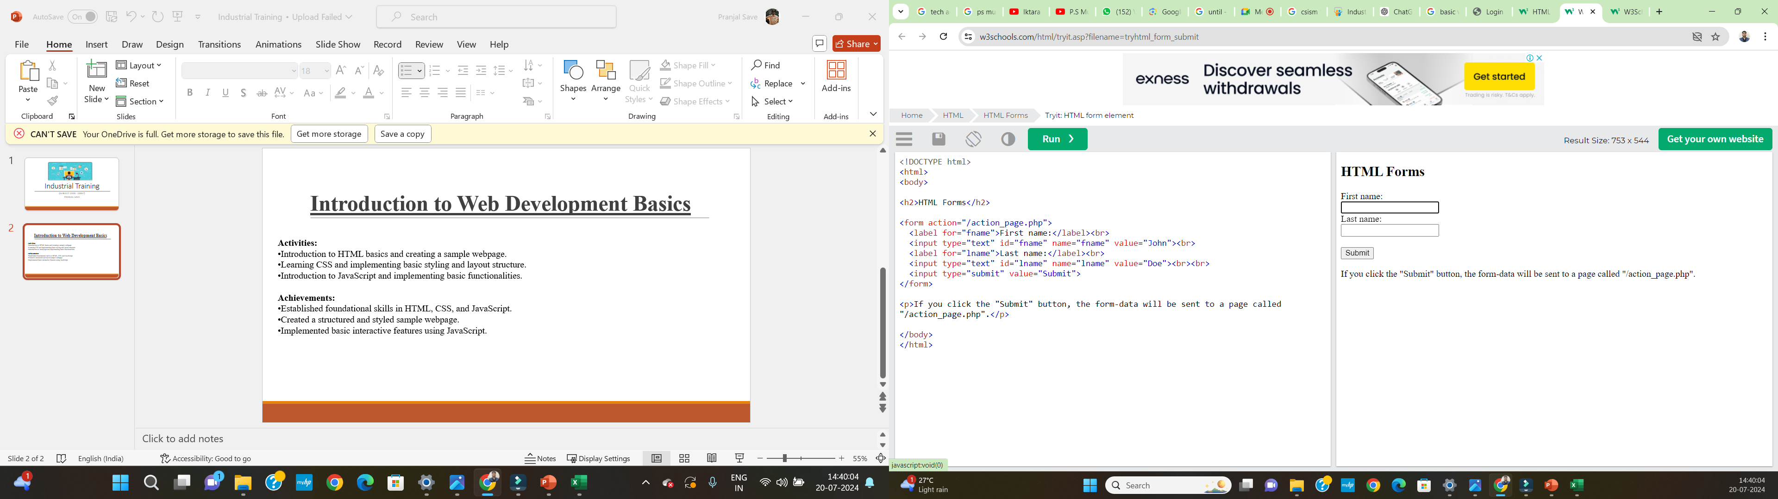
Introduction to Web Development Basics
Week 01
Activities:
Introduction to HTML basics and creating a sample webpage.
Learning CSS and implementing basic styling and layout structure.
Introduction to JavaScript and implementing basic functionalities.
Achievements:
Established foundational skills in HTML, CSS, and JavaScript.
Created a structured and styled sample webpage.
Implemented basic interactive features using JavaScript.

Slide 5
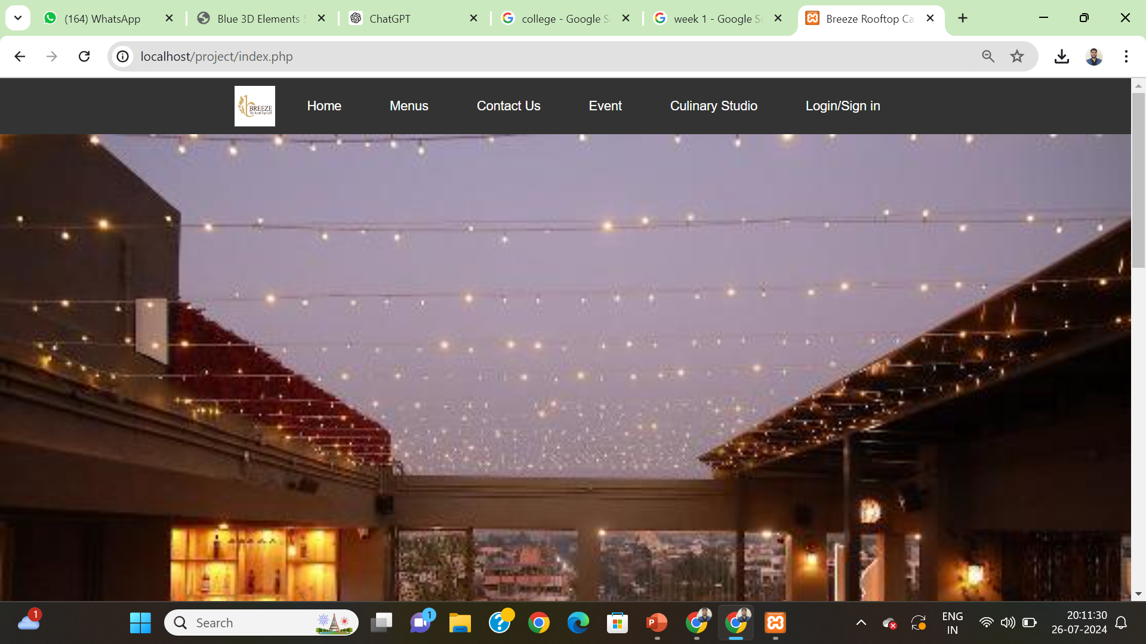
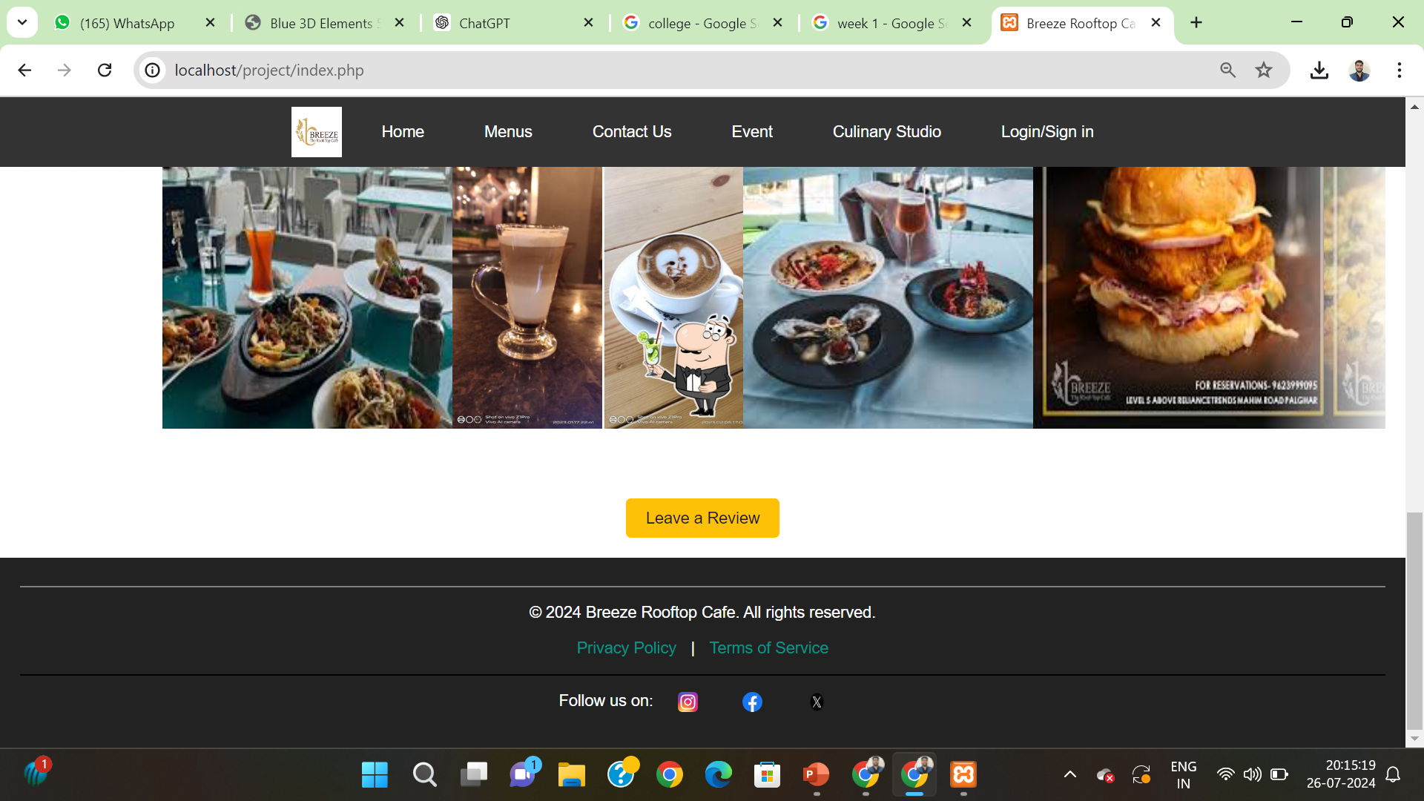

Slide 6
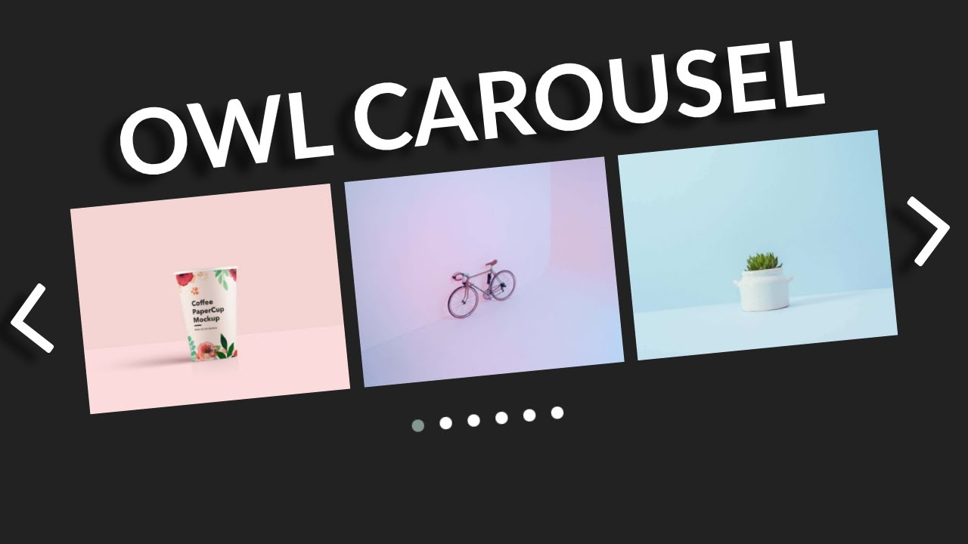
Enhancing User Interaction and Functionality
Week 02
Activities:
Implemented Owl Carousel for auto-scrolling and added Pop-Up functionality.
Developed product details page with image zoom and add-to-cart feature.
Designed a Contact Us page with form controls and integrated it with navigation.
Achievements:
Enhanced user experience with dynamic content presentation.
Improved product showcase and user interaction with advanced features.
Expanded website functionality with user engagement tools.

Slide 7
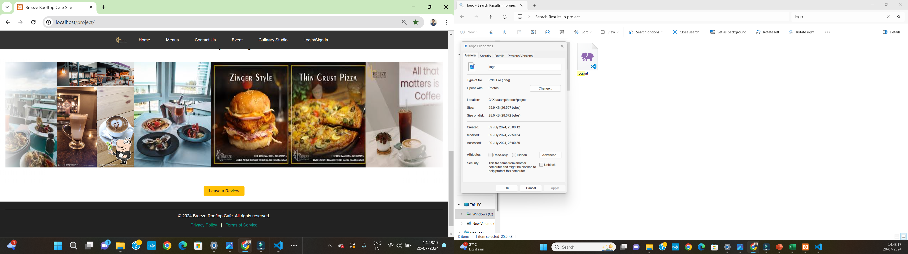
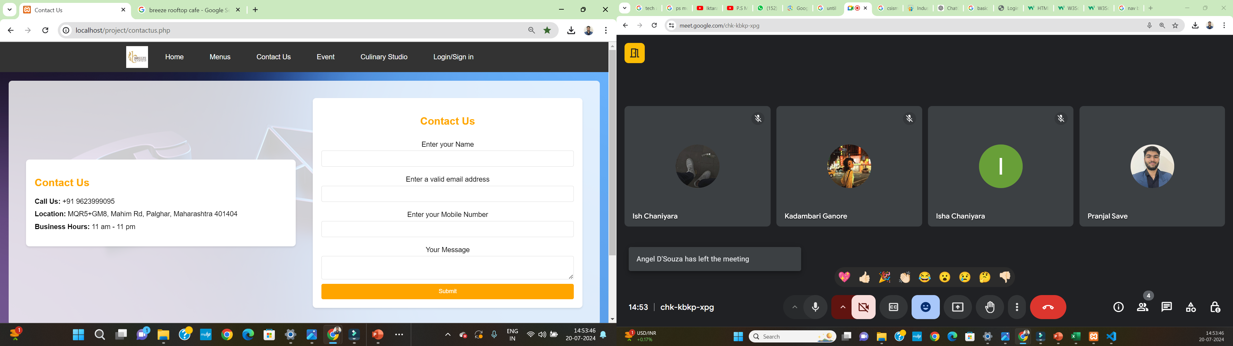
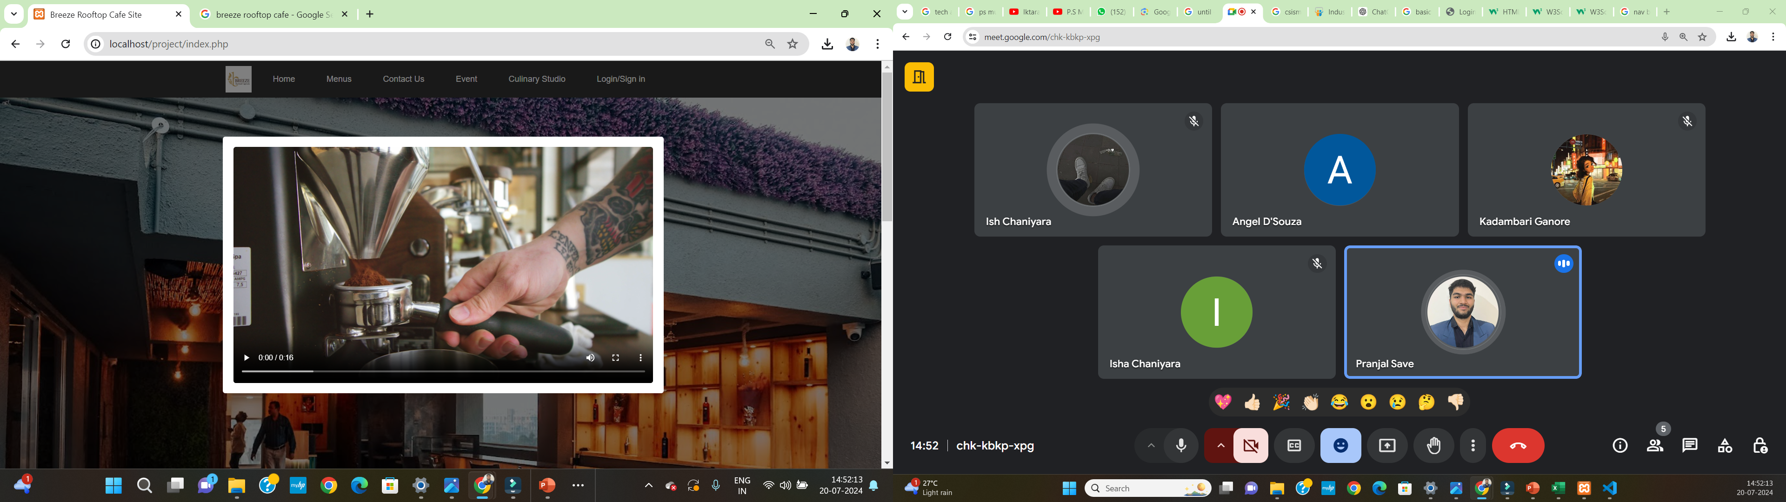

Slide 8

Backend Development and Database Integration
Week 03
Activities:
Introduction to PHP and implementing backend functionalities.
Connected Contact Us form to database; used PHP for data handling.
Developed a Sign-Up page with form validation and database integration.
Achievements:
Initiated backend development with PHP for server-side processing.
Enabled data storage and retrieval for user inquiries and registrations.
Strengthened user interaction and data security with form validation and database integration.

Slide 9
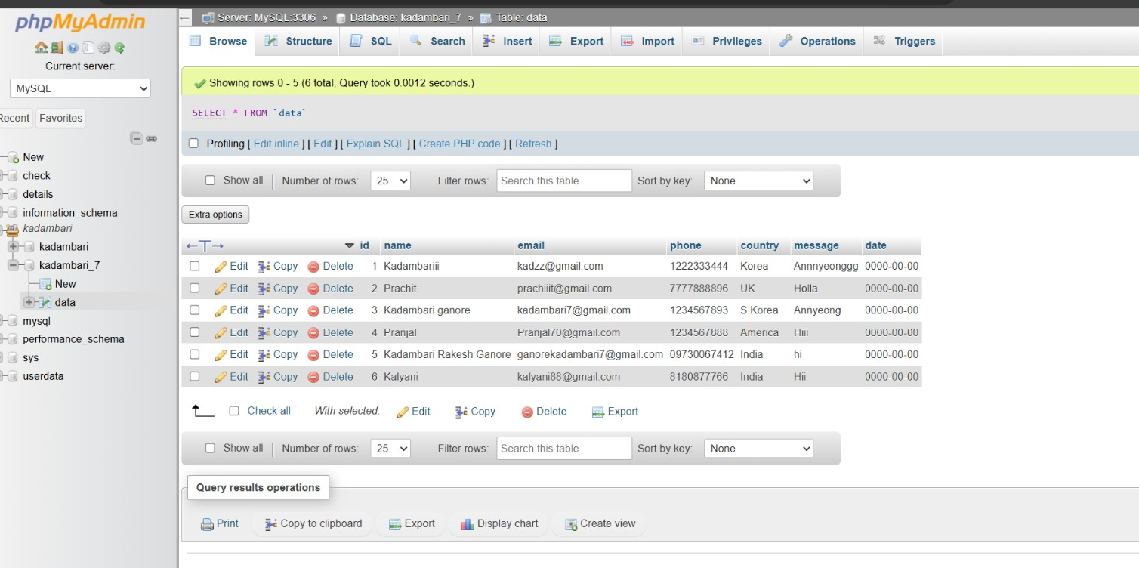
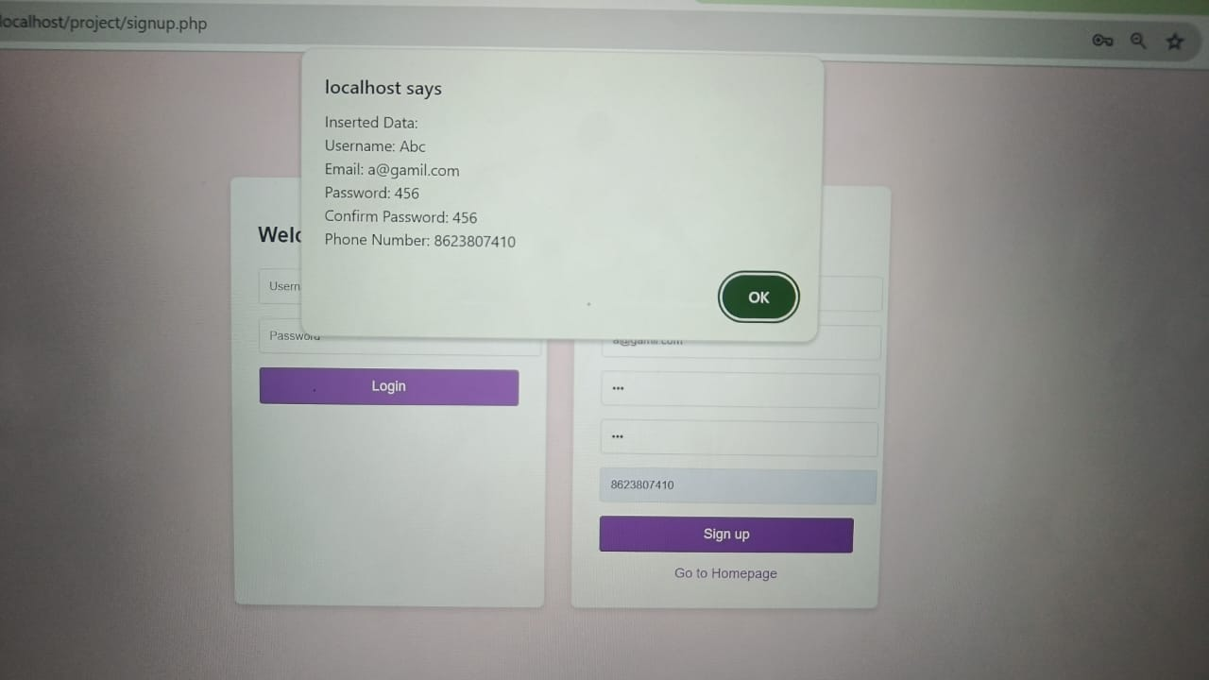

Slide 10

Advanced Database Management
Week 04
Activities:
Implemented operations with SQL queries (update, insert, delete, select).
Integrated database tables into the frontend with interactive features.
Implemented Edit and Delete functionalities using PHP and JavaScript.
Achievements:
Advanced database interaction capabilities .
Enhanced user interface with interactive data management features.
Improved user experience with dynamic content editing and deletion

Slide 11
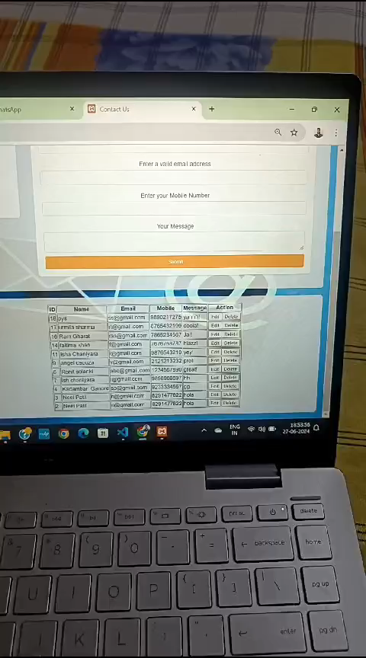

Slide 12

User Interface Design and Deployment Preparation
Week 05
Activities:
Made UI enhancements based on customer feedback (font, color, style changes).
Explored company processes and software deployment strategies.
Added multimedia features like video pop-ups to enhance site attraction.
Achievements:
Improved user engagement with visually appealing design updates.
Gained insights into industry practices for site development and deployment.
Enhanced site attractiveness with multimedia content integration.

Slide 13
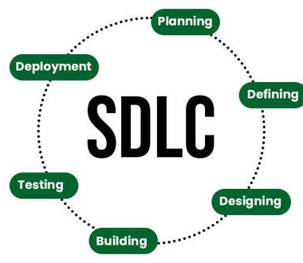

Advanced Web Development Concepts
Week 06
Activities:
Implemented sticky header using CSS for improved navigation.
Explored various software engineering models (e.g., Waterfall Model).
Learned about WordPress, installed it, and created a basic site.
Achievements:
Improved site usability with persistent navigation elements.
Expanded knowledge of structured development methodologies.
Explored alternative web development platforms for future projects.

Slide 14
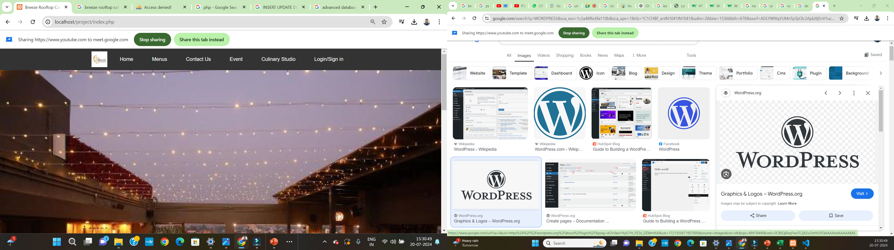
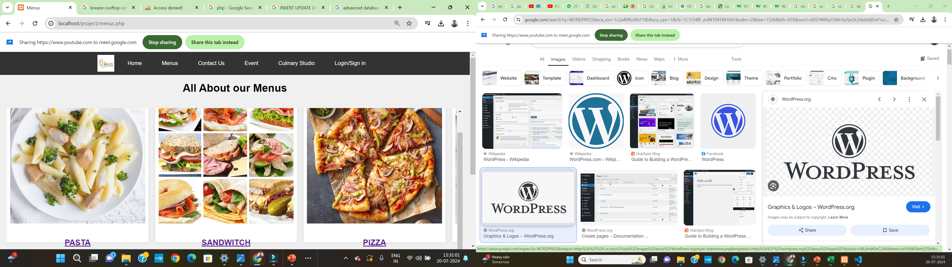
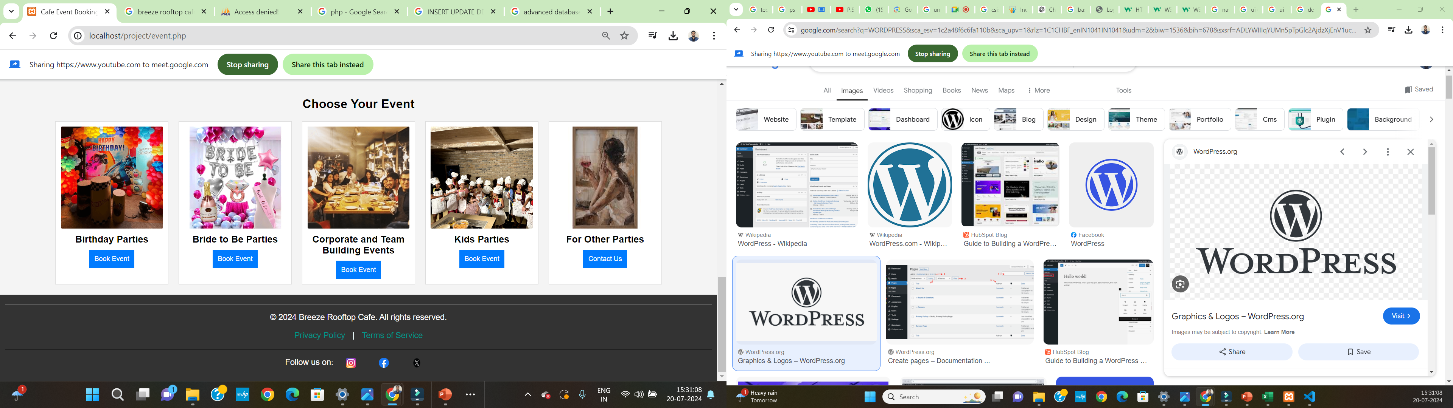
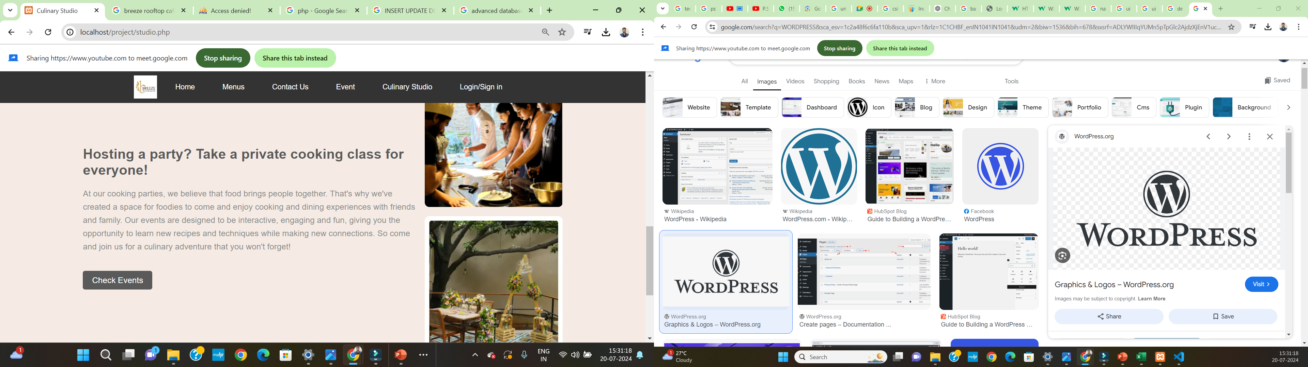

Slide 15
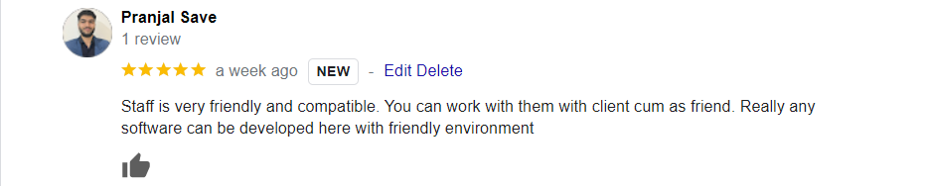
Review About Company
Glad to work in such a company where all the employees are friendly . Which created a Friendly environment.
Usually follows waterfall model to built any software which is simple to implement and faster.
Company has experienced Designers, testers , both developers (Backend and frontend).
Mainly they had shared there experience with us that can be very useful for us.

Slide 16
Suggestion
Also adapt more language which are used in advanced technologies.
Also use more models such as spiral(for risk purpose) and many more.
Should expand the company.

Slide 17
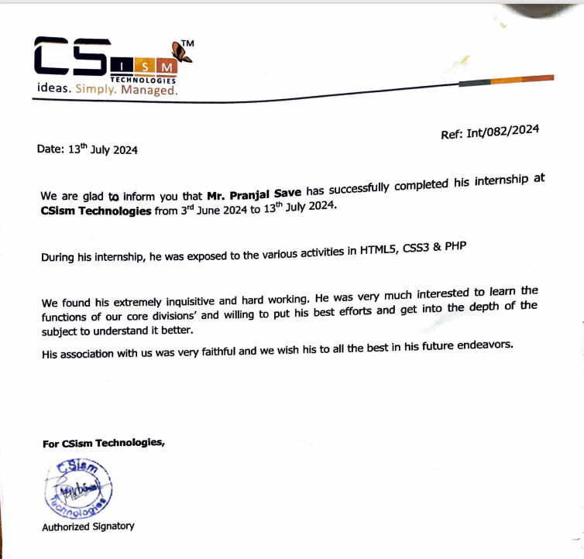
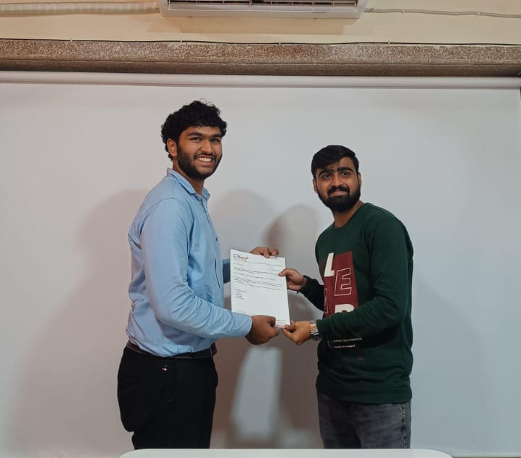
Certification

Slide 18


